Slide 1
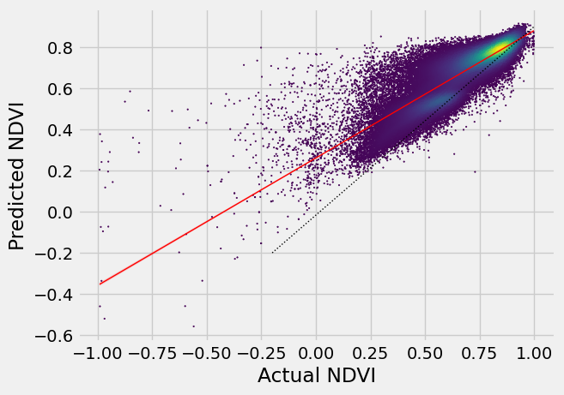
Predicting Wetland Vegetation Vigor using Environmetal Variables
Name
MSc M6 Geoprocessing in python (Winter Term 2022/23)
Motivation & Background
Study site
Wetlands facilitate ecosystem services, regulate climate at local and global scales, and provide niches for endemic and migratory species
Wetlands have been degraded though both
i) historic pressures: land use expansion for agriculture and urbanization
ii) contemporary pressures: climate change and the associated increased drought stress
The Normalized Difference Vegetation Index (NDVI) is a proven metric and proxy of vegetation vitality and can be utilized to assess the impact of drought on plant vigor
It remains unclear how vegetation vigor responds to shifts in water availability in wetlands due to:
i) highly heterogeneous vegetation structures at small spatial scales
ii) high spatial and seasonal variability in local water regime and
iii) greater variation in soil moisture levels. (diminished relationship between drought and plant vigor)
Research Questions:
How reliably can auxiliary environmental variables be used to predict NDVI of wetlands?
How do predictions of NDVI vary spatially and regional difference be attributed to specific auxiliary variables?
How do large-scale climatic events such as wet and drought periods translate into shifts in the predicted NDVI values?
Wetlands In Mecklernburg-Vorpommern and Brandenburg
Composed by lowland bogs, fens, and marshes
water saturated both permanently or seasonally
Workflow
Find, aggregate, and derive relevant data sources from Deutscher Wetter Dienst
soil moisture
de Martonne drought index
SPI: using Multi-annual grids of precipitation
soil data from GEE data catalog
Get NDVI time series from GEE data catalog
Extract feature and target array, tune hyperparameters, fit model, evaluate prediction
Apply trained model to the bigger test data set
Create output maps
Figure caption – maybe a map above?
Key results (1)
Key results (2)
py-Challenges encountered
mae rmse 0.060824 0.082826
…
…
Plat vigor seems to correspond closly to environmental drought conditions. This implies that wetlands act more like conventional vegetation types and that factord such as spatial and seasonal varitability in water regiemes don’t result in a decoupling of the relationship
…
…
…
Your name
name.surname@geo.hu-berlin.de

